Slide 1
Basic Concepts
Computer Organization and Assembly Language
Lec#2
Computer Science Department
National University of Computer and Emerging Sciences Islamabad

Slide 2
Next …
Welcome to COAL 2018
Course Contents
Assembly-, Machine-, and High-Level Languages
Assembly Language Programming Tools
Programmer’s View of a Computer System
Data Representation

Slide 3
Data Representation
Binary Numbers
Hexadecimal Numbers
Base Conversions
Integer Storage Sizes
Binary and Hexadecimal Addition
Signed Integers and 2's Complement Notation
Binary and Hexadecimal subtraction
Carry and Overflow
Character Storage

Slide 4
Number System Used in Assembly
Binary Numbers
  Base is 2
  0 and 1 is allowed
Hexadecimal Numbers
  Base is 16
  0,1,2,3,4,5,6,7,8,9,A,B,C,D,E,F is allowed
Some Notations
  A group of 4 bits is called nibble
  A group of 8 bits is called byte
  A group of 2 bytes is called word
  A group of 2 words is called Double or Doubleword

Slide 5
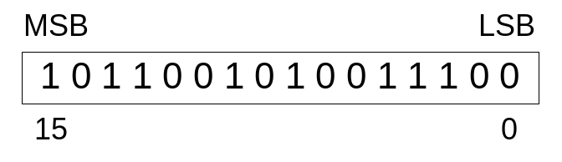
Binary Numbers
Digits are 1 and 0
  1 = true
  0 = false
MSB – most significant bit
LSB – least significant bit
Bit numbering:

Slide 6

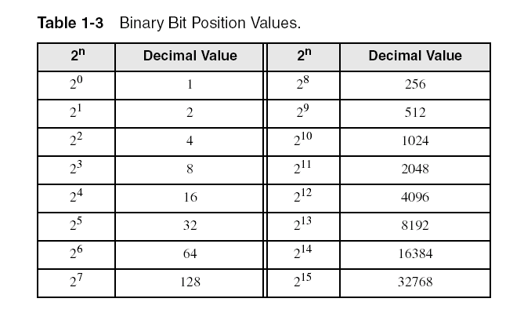
Binary Numbers
Each digit (bit) is either 1 or 0
Each bit represents a power of 2:
Every binary number is a sum of powers of 2

Slide 7
Converting Binary to Decimal
Weighted positional notation shows how to calculate the decimal value of each binary bit:
Decimal = (d_{n-1} × 2^{n-1}) + (d_{n-2} × 2^{n-2}) + ... + (d₁ × 2¹) + (d₀ × 2⁰)
d = binary digit
binary 00001001 = decimal 9:
(1 × 2³) + (1 × 2⁰) = 9

Slide 8
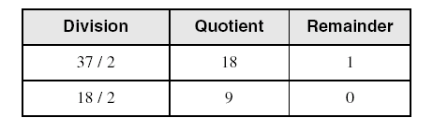
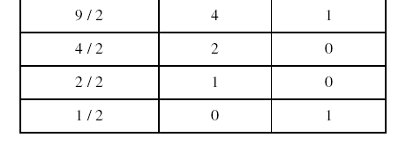
Convert Unsigned Decimal to Binary
Repeatedly divide the decimal integer by 2. Each remainder is a binary digit in the translated value:
least significant bit
most significant bit
37 = 100101
stop when quotient is zero

Slide 9
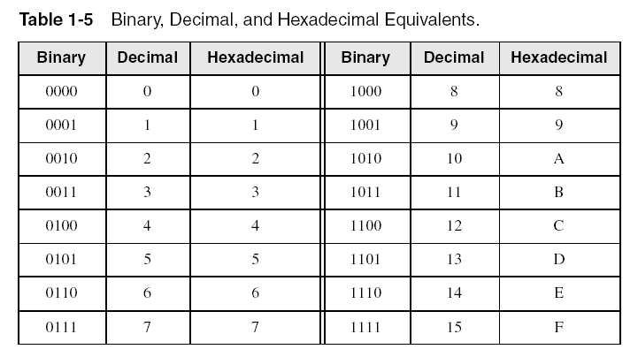
Hexadecimal Integers
Binary values are represented in hexadecimal.

Slide 10

Converting Binary to Hexadecimal
Each hexadecimal digit corresponds to 4 binary bits.
Example: Translate the binary integer 000101101010011110010100 to hexadecimal:

Slide 11
Converting Hexadecimal to Decimal
Multiply each digit by its corresponding power of 16:
Decimal = (d³ × 16³) + (d² × 16²) + (d¹ × 16¹) + (d⁰ × 16⁰)
d = hexadecimal digit
Examples:
  Hex 1234 = (1 × 16³) + (2 × 16²) + (3 × 16¹) + (4 × 16⁰) =
  Decimal 4,660
  Hex 3BA4 = (3 × 16³) + (11 * 16²) + (10 × 16¹) + (4 × 16⁰) =
  Decimal 15,268

Slide 12
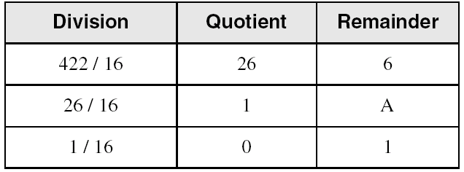
Converting Decimal to Hexadecimal
Repeatedly divide the decimal integer by 16. Each remainder is a hex digit in the translated value:
least significant digit
most significant digit
stop when quotient is zero
Decimal 422 = 1A6 hexadecimal

Slide 13

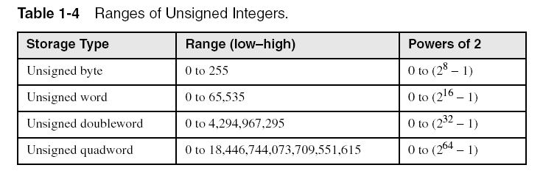
Integer Storage Sizes
Standard sizes:
What is the largest unsigned integer that may be stored in 20 bits?

Slide 14
Binary Addition
Start with the least significant bit (rightmost bit)
Add each pair of bits
Include the carry in the addition, if present
carry:
1
0
0
0
0
0
1
0
0
(4)
+
0
0
0
0
0
1
1
1
(7)
0
0
0
0
1
0
1
1
(11)
bit position:
7
6
5
4
3
2
1
0

Slide 15
Hexadecimal Addition
Divide the sum of two digits by the number base (16). The quotient becomes the carry value, and the remainder is the sum digit.
1
1
36 28 28 6A
42 45 58 4B
78 6D 80 B5
21 / 16 = 1, remainder 5
Important skill: Programmers frequently add and subtract the addresses of variables and instructions.

Slide 16
Signed Integers
Several ways to represent a signed number
  Biased
  2's complement
Divide the range of values into 2 equal parts
  First part corresponds to the positive numbers (≥ 0)
  Second part correspond to the negative numbers (< 0)
Focus will be on the 2's complement representation
  Has many advantages over other representations
  Used widely in processors to represent signed integers

Slide 17
Representation of negative numbers
Is a representation of negative numbers possible?
Unfortunately:
  you can not just stick a negative sign in front of a binary number. (it does not work like that)
Two methods used to represent negative numbers.
  Excess notation
  Two’s complement notation

Slide 18
Excess Representation
(cont.)
  For a given fixed number of bits the range is remapped such that roughly half the numbers are negative and half are positive.
  Example: (as left)
  Excess 8 -> notation for 4 bit numbers
  MSB can be used as a sign bit, but
    If MSB =1, positive number
    If MSB =0, negative number
  Excess Representation is also called bias
Excess Value | Notation | Number to store
0 1 2 3 4 5 6 7 8 9 10 11 12 13 14 15 | 0000 0001 0010 0011 0100 0101 0110 0111 1000 1001 1010 1011 1100 1101 1110 1111 | -8 -7 -6 -5 -4 -3 -2 -1 0 1 2 3 4 5 6 7

Slide 19
Biased-Excess-N
Uses a pre-specified number N as a biasing value.
A value is represented by the unsigned number which is N greater than the intended value.
  0 is represented by N,
  −N is represented by the all-zeros bit pattern.

Slide 20
Two's Complement Representation
Positive numbers
  Signed value = Unsigned value
Negative numbers
  UnSigned value = Signed value + 2^{n}
  n = number of bits
Negative weight for MSB
  Another way to obtain the signed value is to assign a negative weight to most-significant bit
  = -128 + 32 + 16 + 4 = -76
8-bit Binary value | Unsigned value | Signed value
00000000 | 0 | 0
00000001 | 1 | +1
00000010 | 2 | +2
. . . | . . . | . . .
01111110 | 126 | +126
01111111 | 127 | +127
10000000 | 128 | -128
10000001 | 129 | -127
. . . | . . . | . . .
11111110 | 254 | -2
11111111 | 255 | -1
1
0
1
1
0
1
0
0
-128
64
32
16
8
4
2
1
Notes:
Another Way::
Signed Value→-1
2^{n}-(1)=256-1=255=Binary(11111111)

Slide 21
Forming the Two's Complement
starting value | 00100100 = +36
step1: reverse the bits (1's complement) | 11011011
step 2: add 1 to the value from step 1 | + 1
sum = 2's complement representation | 11011100 = -36
Sum of an integer and its 2's complement must be zero:
00100100 + 11011100 = 00000000 (8-bit sum) ⇒ Ignore Carry
The easiest way to obtain the 2's complement of a binary number is by starting at the LSB, leaving all the 0s unchanged, look for the first occurrence of a 1. Leave this 1 unchanged and complement all the bits after it.

Slide 22
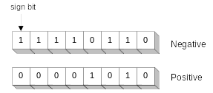
Sign Bit
Highest bit indicates the sign. 1 = negative, 0 = positive
If highest digit of a hexadecimal is > 7, the value is negative
Examples: 8A and C5 are negative bytes
A21F and 9D03 are negative words
B1C42A00 is a negative double-word

Slide 23
Sign Extension
Step 1: Move the number into the lower-significant bits
Step 2: Fill all the remaining higher bits with the sign bit
This will ensure that both magnitude and sign are correct
Examples
  Sign-Extend 10110011 to 16 bits
  Sign-Extend 01100010 to 16 bits
Infinite 0s can be added to the left of a positive number
Infinite 1s can be added to the left of a negative number
10110011 = -77
11111111 10110011 = -77
01100010 = +98
00000000 01100010 = +98

Slide 24
Two's Complement of a Hexadecimal
To form the two's complement of a hexadecimal
  Subtract each hexadecimal digit from 15
  Add 1
Examples:
  2's complement of 6A3D = 95C2 + 1 = 95C3
  2's complement of 92F0 = 6D0F + 1 = 6D10
  2's complement of FFFF = 0000 + 1 = 0001
No need to convert hexadecimal to binary

Slide 25
Binary Subtraction
When subtracting A – B, convert B to its 2's complement
Add A to (–B)
0 0 0 0 1 1 0 0 0 0 0 0 1 1 0 0
0 0 0 0 0 0 1 0 1 1 1 1 1 1 1 0 (2's complement)
0 0 0 0 1 0 1 0 (same result)
Carry is ignored, because
  Negative number is sign-extended with 1's
  You can imagine infinite 1's to the left of a negative number
  Adding the carry to the extended 1's produces extended zeros
–
+
Practice: Subtract 00100101 from 01101001.
Notes:
01000100

Slide 26
Hexadecimal Subtraction
When a borrow is required from the digit to the left, add 16 (decimal) to the current digit's value
Last Carry is ignored
16 + 5 = 21
-1
1
1
C675
A247
242E
C675
5DB9 (2's complement)
242E (same result)
-
+
Practice: The address of var1 is 00400B20. The address of the next variable after var1 is 0040A06C. How many bytes are used by var1?
Notes:
954C Bytes

Slide 27
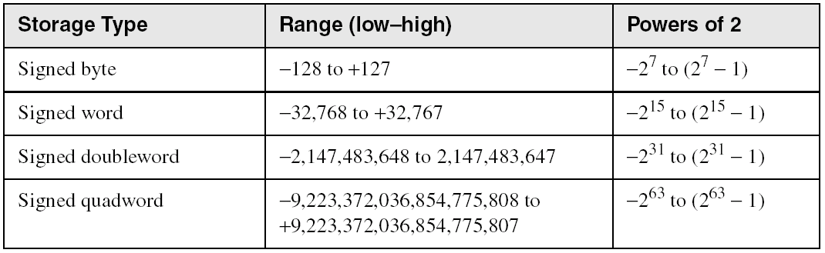
Ranges of Signed Integers
The unsigned range is divided into two signed ranges for positive and negative numbers
Practice: What is the range of signed values that may be stored in 20 bits?

Slide 28
Carry and Overflow
Carry is important when …
  Adding or subtracting unsigned integers
  Indicates that the unsigned sum is out of range
  Either < 0 or >maximum unsigned n-bit value
Overflow is important when …
  Adding or subtracting signed integers
  Indicates that the signed sum is out of range
Overflow occurs when
  Adding two positive numbers and the sum is negative
  Adding two negative numbers and the sum is positive
  Can happen because of the fixed number of sum bits

Slide 29
Carry and Overflow Examples
We can have carry without overflow and vice-versa
Four cases are possible
1
1
1
1
1
1
0
0
0
0
1
1
1
1
15
0
0
0
0
1
1
1
1
15
+
+
0
0
0
0
1
0
0
0
8
1
1
1
1
1
0
0
0
248 (-8)
0
0
0
1
0
1
1
1
23
0
0
0
0
0
1
1
1
263
(+7)
Carry = 0 Overflow = 0
Carry = 1 Overflow = 0
1
1
1
1
0
1
0
0
1
1
1
1
79
1
1
0
1
1
0
1
0
218 (-38)
+
+
0
1
0
0
0
0
0
0
64
1
0
0
1
1
1
0
1
157 (-99)
1
0
0
0
1
1
1
1
143
(-113)
0
1
1
1
0
1
1
1
375
(-137)
Carry = 0 Overflow = 1
Carry = 1 Overflow = 1
Notes:
Perhaps the most elegant solution is to check for the sign of the sum and compare it against the signs of the numbers added.

Slide 30
Character Storage
Character sets
  Standard ASCII: 7-bit character codes (0 – 127)
  Extended ASCII: 8-bit character codes (0 – 255)
  Unicode: 16-bit character codes (0 – 65,535)
  Unicode standard represents a universal character set
    Defines codes for characters used in all major languages
    Used in Windows-XP: each character is encoded as 16 bits
  UTF-8: variable-length encoding used in HTML
    Encodes all Unicode characters
    Uses 1 byte for ASCII, but multiple bytes for other characters
Null-terminated String
  Array of characters followed by a NULL character
Notes:
UTF-8->8-bit Unicode Transformation Format

Slide 31
Printable ASCII Codes
 | 0 | 1 | 2 | 3 | 4 | 5 | 6 | 7 | 8 | 9 | A | B | C | D | E | F
2 | space | ! | " | # | $ | % | & | ' | ( | ) | * | + | , | - | . | /
3 | 0 | 1 | 2 | 3 | 4 | 5 | 6 | 7 | 8 | 9 | : | ; | < | = | > | ?
4 | @ | A | B | C | D | E | F | G | H | I | J | K | L | M | N | O
5 | P | Q | R | S | T | U | V | W | X | Y | Z | [ | \ | ] | ^ | _
6 | ` | a | b | c | d | e | f | g | h | i | j | k | l | m | n | o
7 | p | q | r | s | t | u | v | w | x | y | z | { | | | } | ~ | DEL
Examples:
  ASCII code for space character = 20 (hex) = 32 (decimal)
  ASCII code for 'L' = 4C (hex) = 76 (decimal)
  ASCII code for 'a' = 61 (hex) = 97 (decimal)

Slide 32
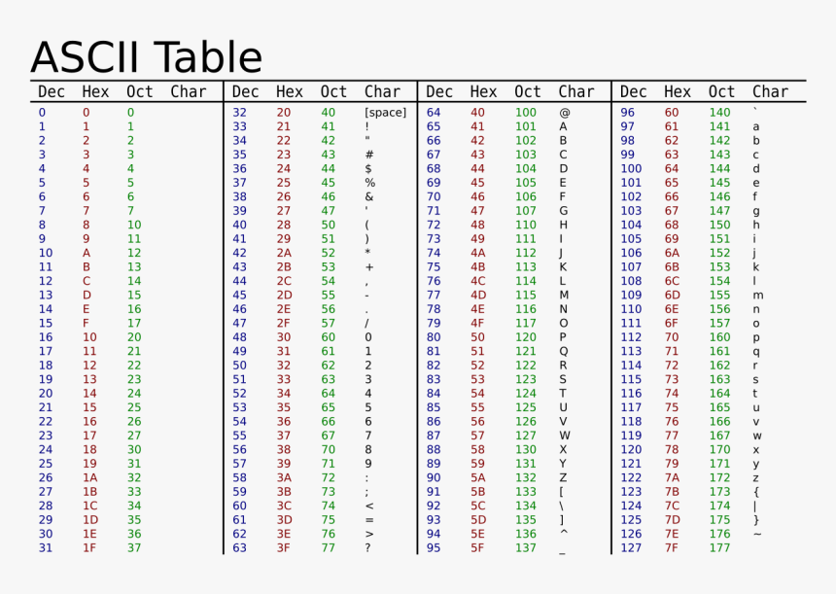

Slide 33
Control Characters
The first 32 characters of ASCII table are used for control
Control character codes = 00 to 1F (hex)
Examples of Control Characters
  Character 0 is the NULL character ⇒ used to terminate a string
  Character 9 is the Horizontal Tab (HT) character
  Character 0A (hex) = 10 (decimal) is the Line Feed (LF)
  Character 0D (hex) = 13 (decimal) is the Carriage Return (CR)
  The LF and CR characters are used together
    They advance the cursor to the beginning of next line
One control character appears at end of ASCII table
  Character 7F (hex) is the Delete (DEL) character

Slide 34
Terminology for Data Representation
Binary Integer
  Integer stored in memory in its binary format
  Ready to be used in binary calculations
ASCII Digit String
  A string of ASCII digits, such as "123"
ASCII binary
  String of binary digits: "01010101"
ASCII decimal
  String of decimal digits: "6517"
ASCII hexadecimal
  String of hexadecimal digits: "9C7B"

Slide 35
Summary
Assembly language helps you learn how software is constructed at the lowest levels
Assembly language has a one-to-one relationship with machine language
An assembler is a program that converts assembly language programs into machine language
A linker combines individual files created by an assembler into a single executable file
A debugger provides a way for a programmer to trace the execution of a program and examine the contents of memory and registers
A computer system can be viewed as consisting of layers. Programs at one layer are translated or interpreted by the next lower-level layer
Binary and Hexadecimal numbers are essential for programmers working at the machine level.

